Slide 1
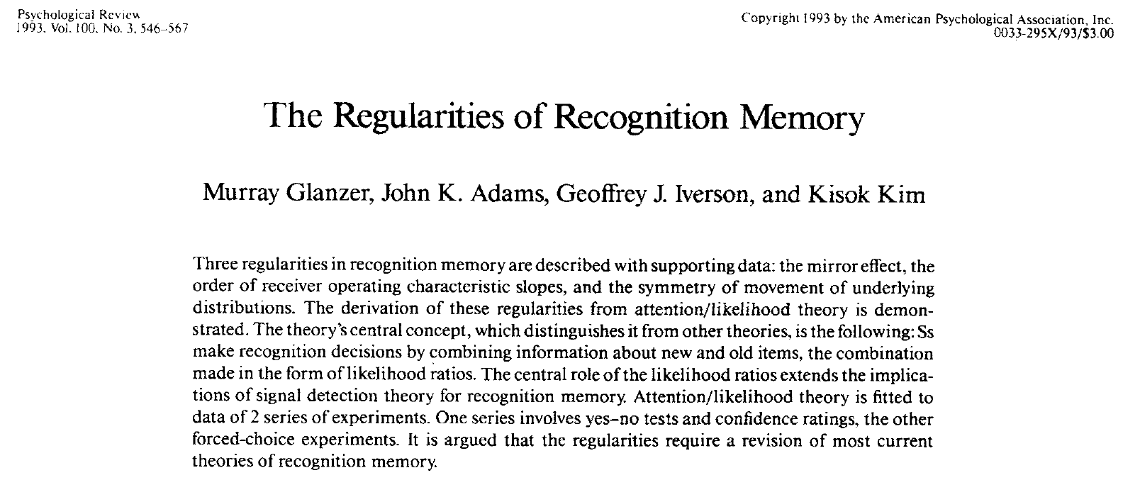
According to this article:

Slide 2
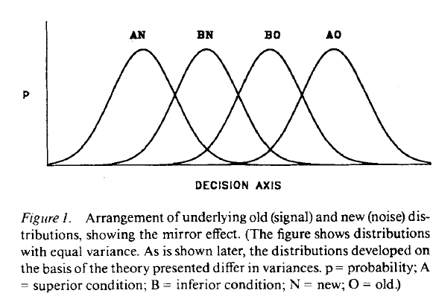
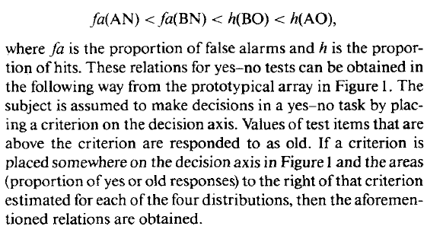
1) There’s a single criterion

Slide 3
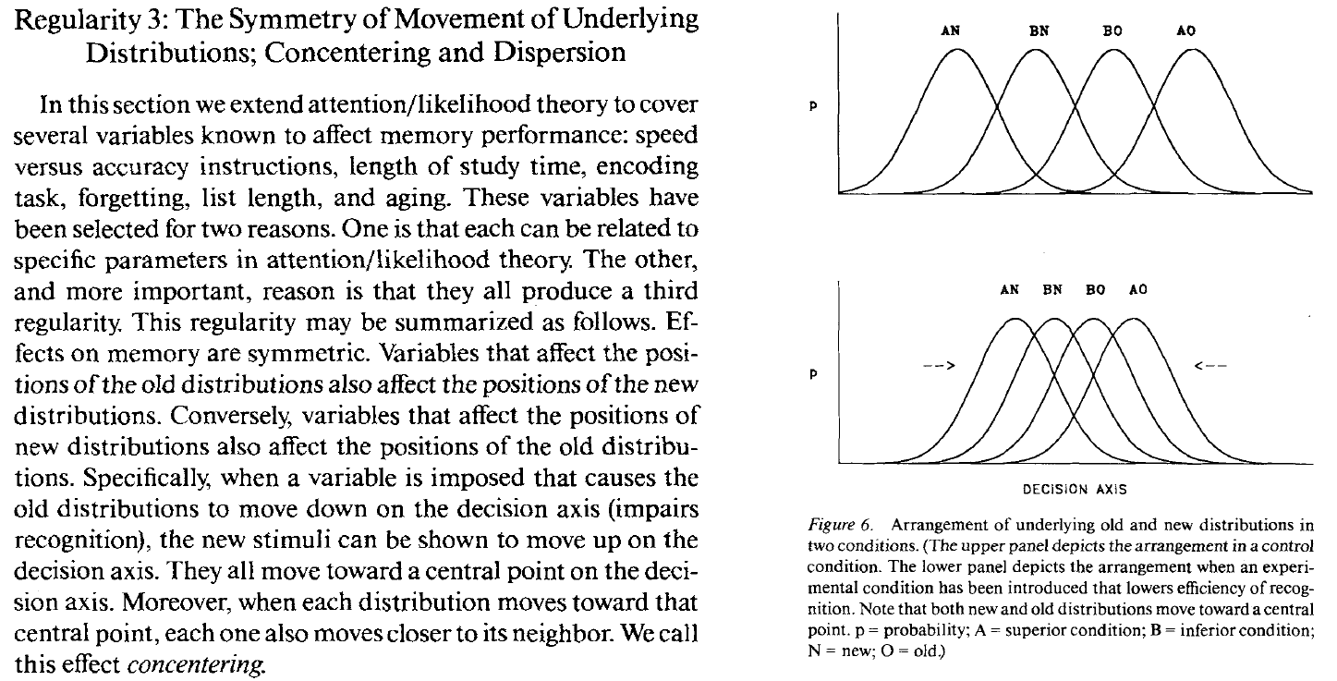
2)

Slide 4
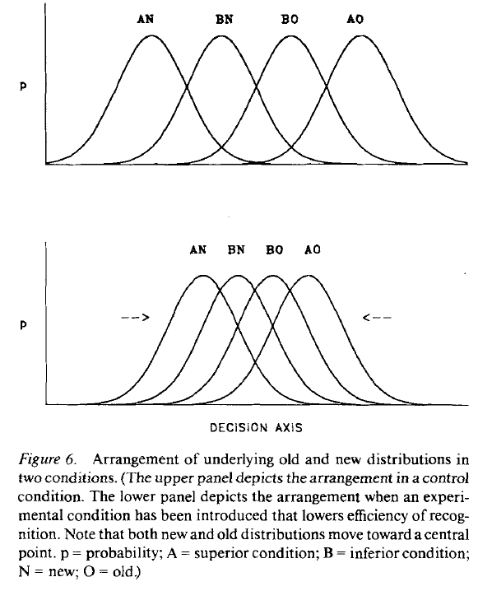
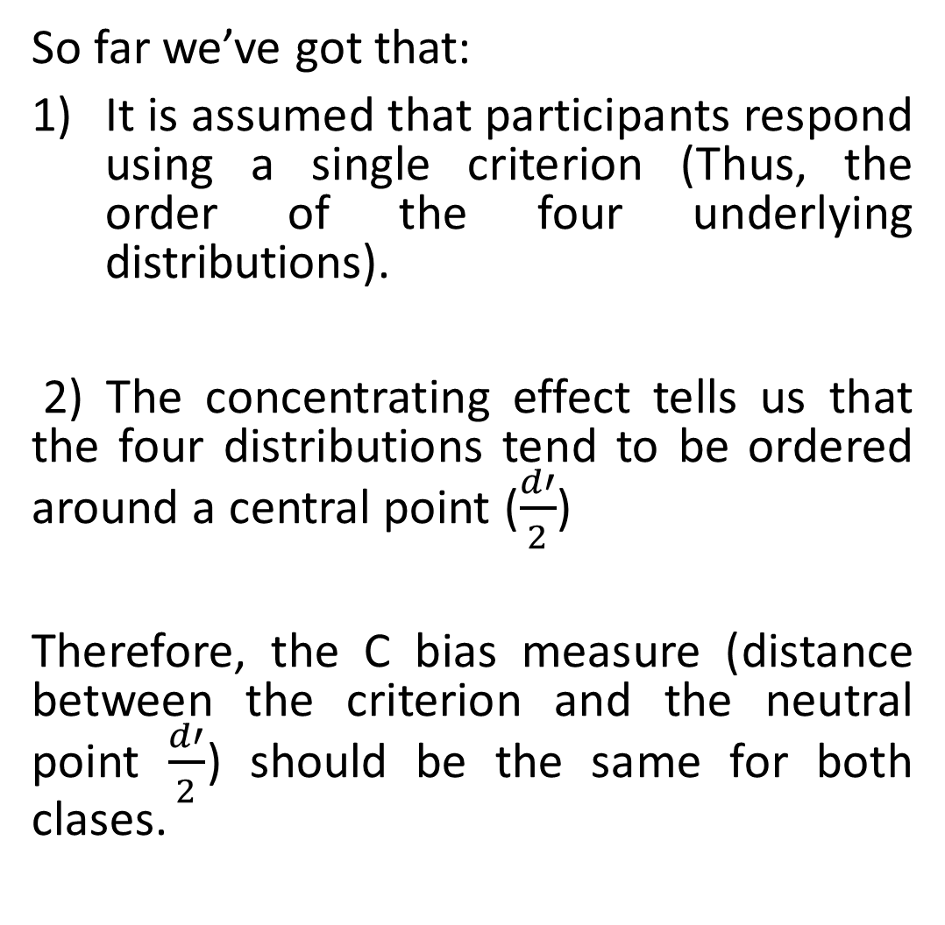
So far we’ve got that:
It is assumed that participants respond using a single criterion (Thus, the order of the four underlying distributions).
2) The concentrating effect tells us that the four distributions tend to be ordered around a central point ($\frac{d′}{2}$)
Therefore, the C bias measure (distance between the criterion and the neutral point $\frac{d′}{2}$) should be the same for both clases.

Slide 5
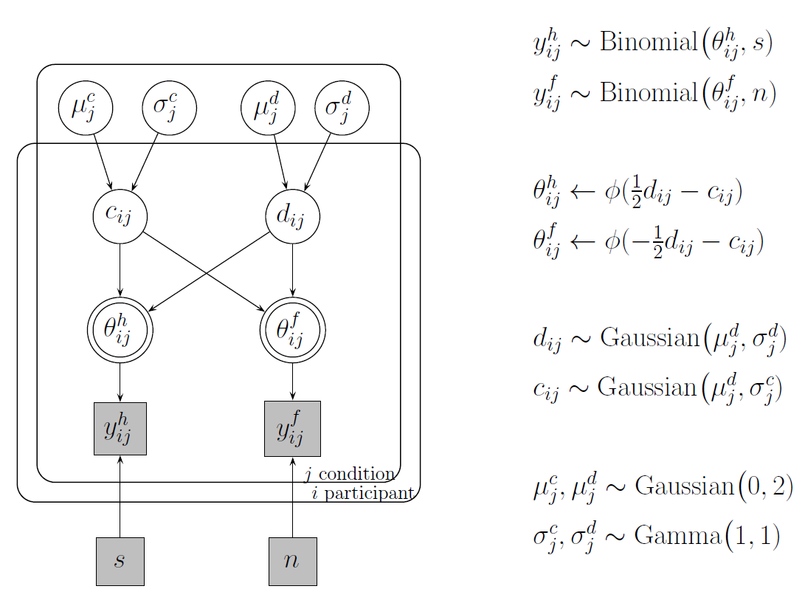
We apply a Hierarchical Bayesian SDT model

Slide 6
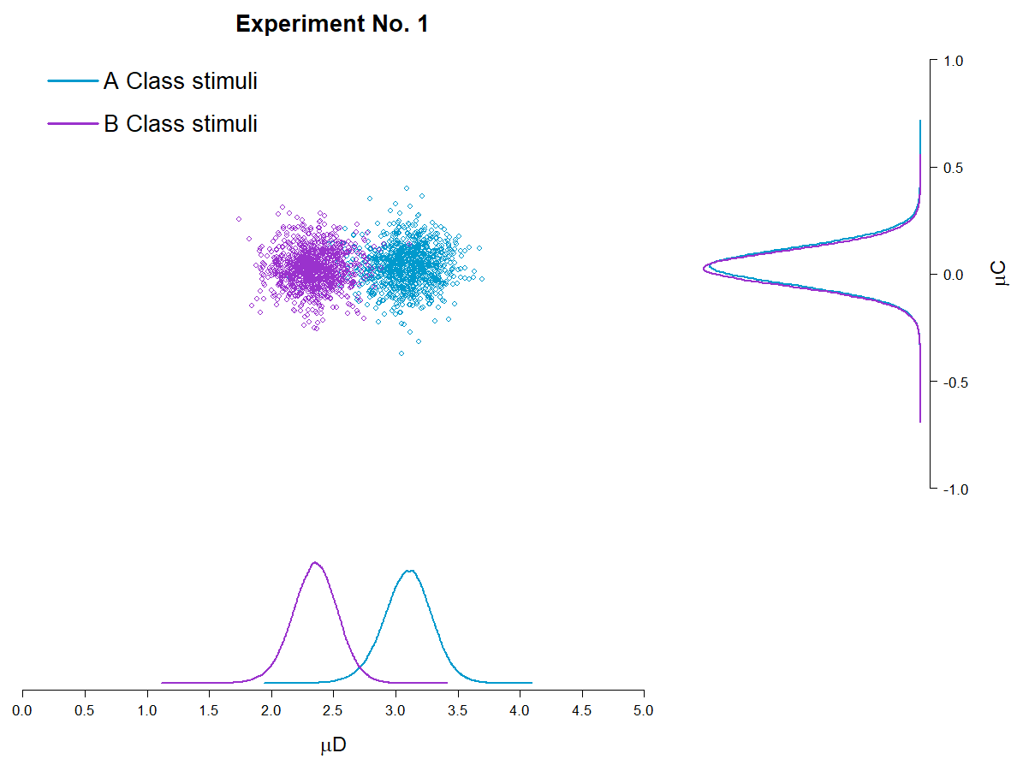
Plot 1
It is interesting to note that for Experiment No. 1, yes, some differences are found in terms of the mean d’ estimations for each class of stimuli, but this doesn’t happen for C, which according to the proposed hierarchical model could be described by the same mean value for both classes of stimuli.

Slide 7
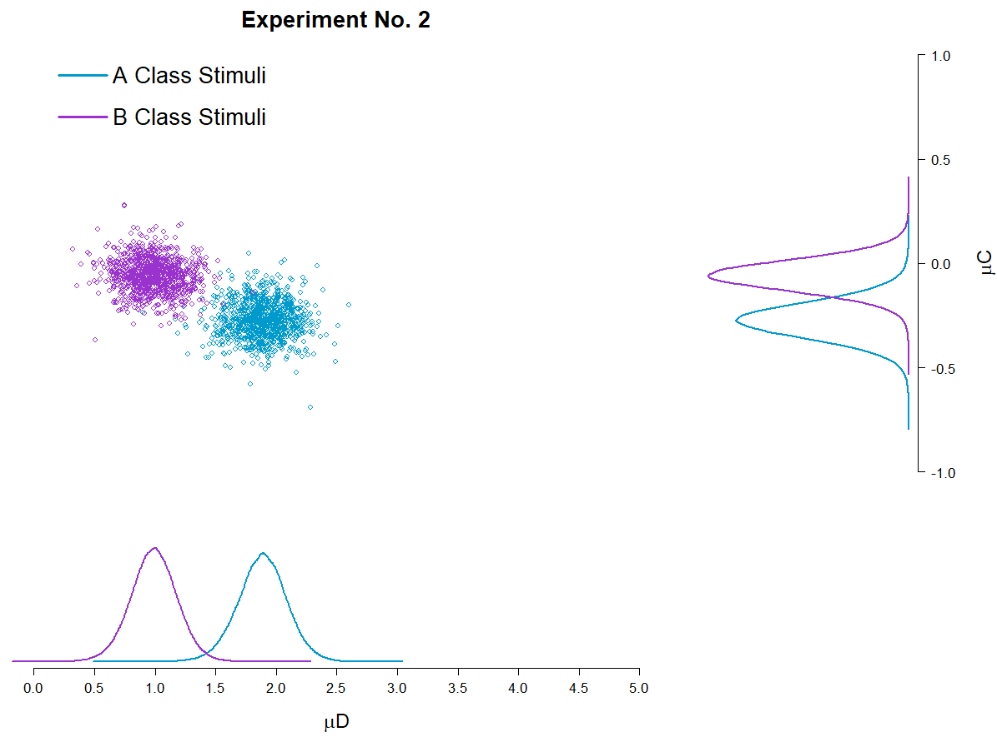
Plot 1
Even more interesting should be the fact that this doesn’t hold up for Experiment No. 2, where differences between classes of stimuli are observed both for d’ and C.

